Slide 1




XCA Deferred Response Option
Presented by Joe Lamy

Slide 2
The problem
Need for long-latency XCA query and retrieve
Clinical data held by responder in legacy paper documents
Manual access determination involving human evaluation
Deep search into secondary archives
Etc.
Need to delay for hours, days…
Need for requests to survive over system restarts

Slide 3
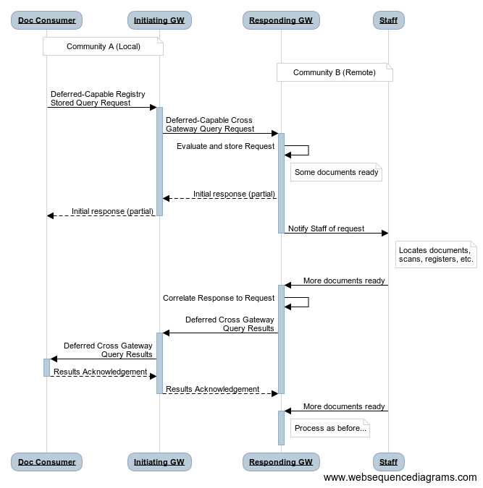
The solution
XCA Deferred Response Option
Allows Responding Gateway to return some results immediately, then in multiple Results messages
Also allows grouping with a Document Consumer

